Slide 1
Class 8

Slide 2
What features is included in baseline ServiceNow without plugin activation?
Incident Management
Which of the following are customization in ServiceNow?
Writing a script, creating a business rule that overrides out-of-box functionality.
Diff between app and plugin?
Plugin (made by ServiceNow) adds specific platform functionality, application (could be done by partners) is a package of modules that provide a business solution.
When working in a custom app scope and trying to modify a global table like incident which of the following steps might be required?
Switch to the scope that owns the incident table
Request cross-scope write access

Slide 3
Users and Roles

Slide 4
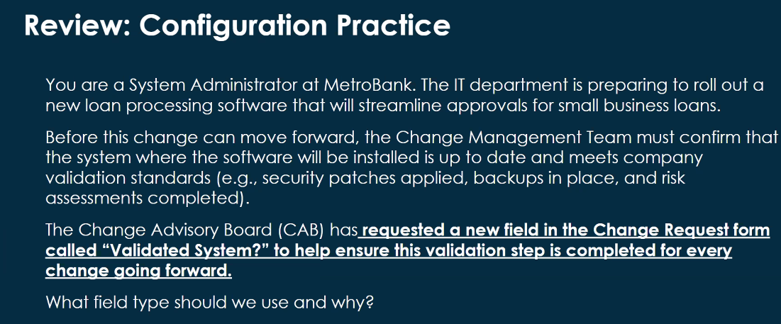
Review: Configuration Practice

Slide 5
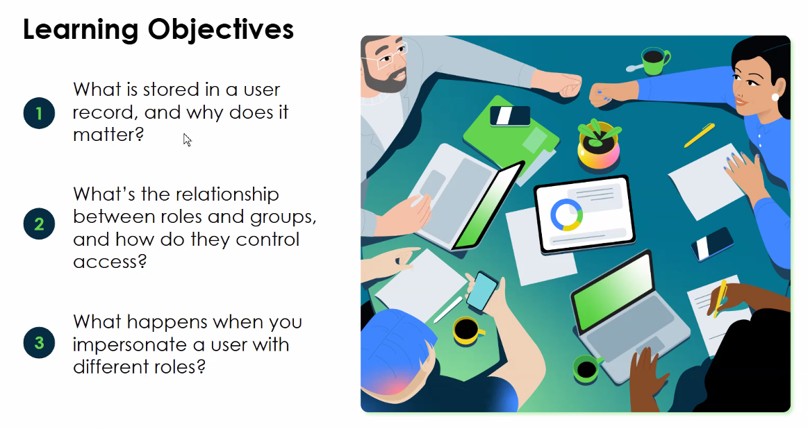

Slide 6
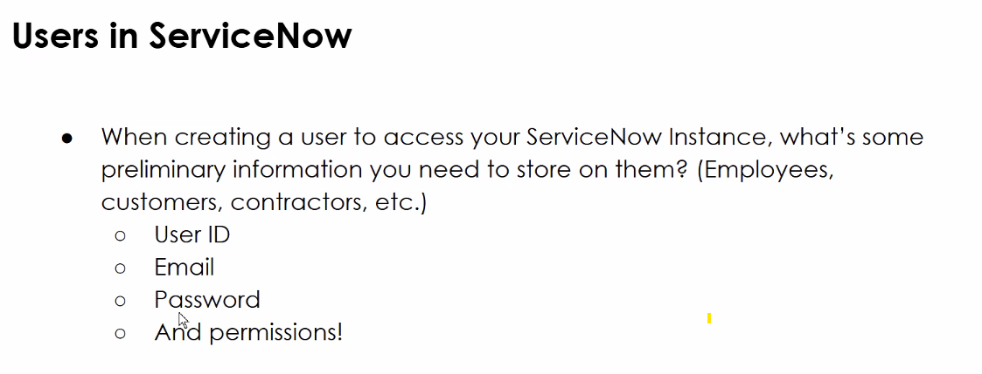

Slide 7
Roles have permissions attached, you assign roles to groups
Parent child relationship, everything that a child can do + specific permissions for a parent.
Permissions = roles. Roles are assigned to group. Job title = group.
Roles are collections of permissions, while permissions define specific actions users are allowed to access.
If it helps AWS defines it as : roles are entities you create and assign specific permissions to that allow trusted identities such as workforce identities and applications to perform actions in AWS

Slide 8
Users are a record on the User [sys-user] table

Slide 9
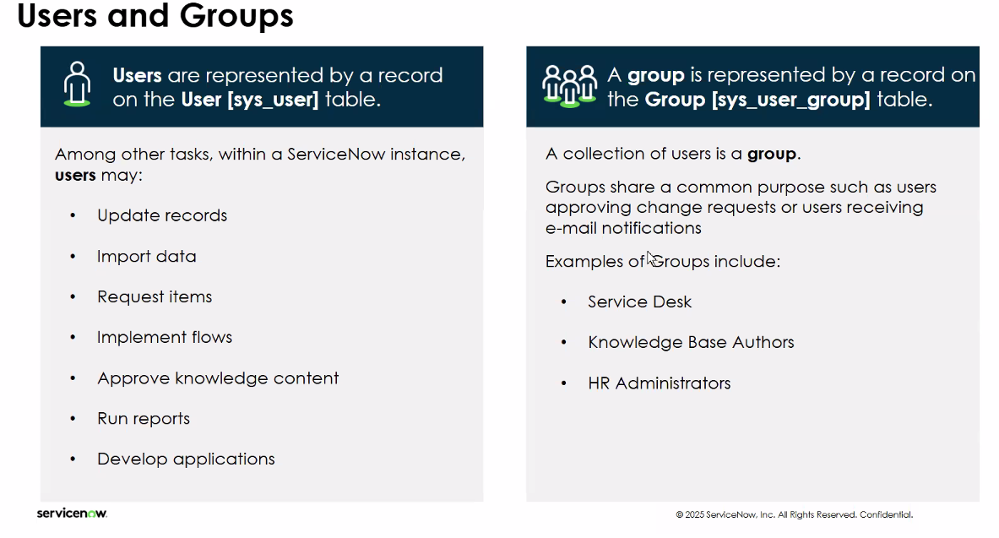

Slide 10
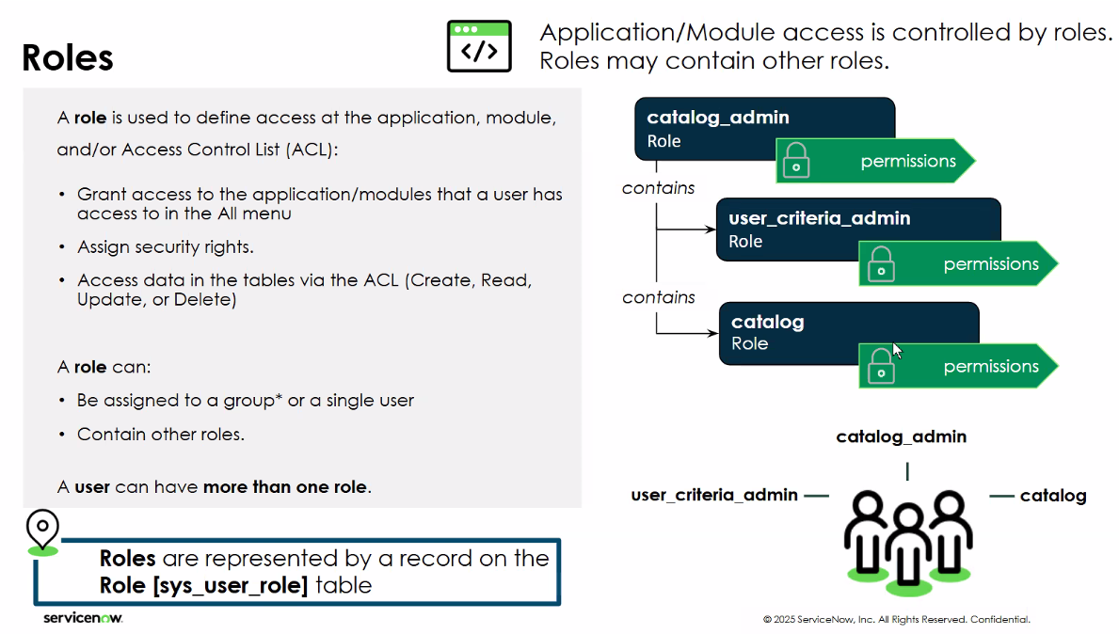

Slide 11
Parent has roles that a child has but also some extra roles

Slide 12
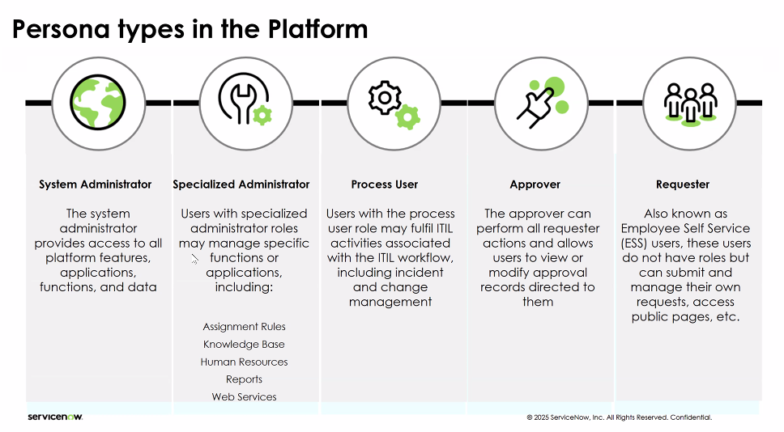

Slide 13
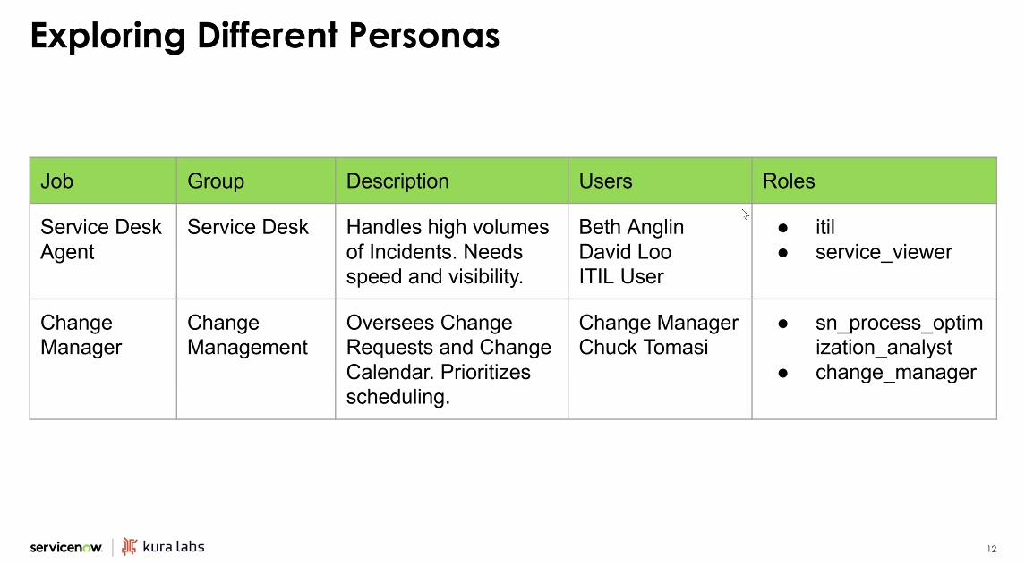

Slide 14
Walkthrough
Assign Catalog Admin Role to the Catalog Request Approves for Sales Group

